Slide 1

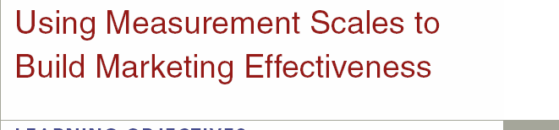
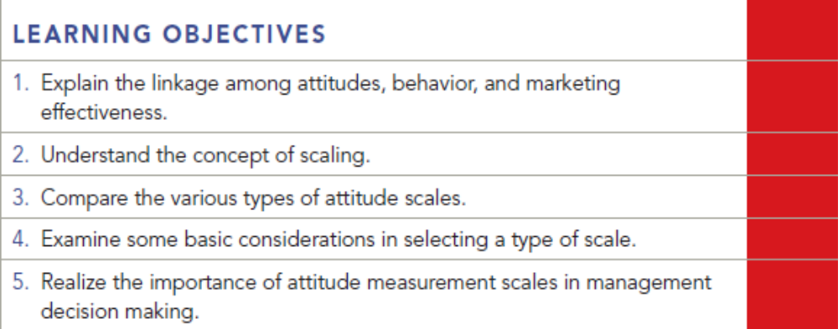
Chapter Eleven
11-1

Slide 2
Question
What are some of the arguments for and against having a neutral point on a scale?

Slide 3
Answer
One of the disadvantages of having a neutral point is that researchers run the risk of respondents choosing the neutral category for most responses. This outcome can be a problem when researchers are trying to determine a positive or negative attitude about the characteristic of interest that is being measured.
If the researcher does not use a neutral point, then some valuable information may be lost in that some people may choose not to answer the question because they truly feel neutral or indifferent. The key to resolving this issue occurs at the exploratory research stage. The key question is, “are neutral responses necessary given the question being asked?” If the differences of opinion are fairly sharp, and people are opinionated at the exploratory stage, then the neutral response is not necessary. However, if the question deals with something in which respondents could be neutral, then the midpoint neutral response should be there.

Slide 4
Question
The local department store in your home town has been besieged by competition from the large national chains. What are some ways that target customers' attitudes toward the store could be changed?

Slide 5
Answer
If there are several large chains, the local store cannot compete only on product assortment or price. It must find some other sustainable competitive advantage. Research could be conducted to determine what the customers’ current attitudes toward the store are and what they value most in a department store. If the customers value personal service, the store must provide it and use this element in their promotions and advertising. If the customers believe in home-town values, the store could focus on its history in the community, while promoting an updated image.

Slide 6
Question
Develop a Likert scale to evaluate the parks and recreation department in your city

Slide 7
Answer
Likert Scales have to do with extent of agreement with a statement. Hence:
City Park is a well-maintained park.
Strongly Somewhat Neutral Somewhat Strongly
Agree Agree Agree Agree

Slide 8
Question
Develop a purchase intent scale for students eating at the university’s cafeteria. How might the reliability and validity of this scale be measured? Why do you think purchase intent scales are so popular in commercial marketing research?

Slide 9
Answer
How likely is it that you will buy a 19-meal card this semester?
Definitely Will, Probably Will, Might, Probably Will Not, Definitely Will Not
The reliability could be measured by a test-retest reliability check of the scale. Validity could be measured by considering the content, the predictability, and whether it looks like it is measuring what it is supposed to be measuring.
These scales are important for commercial researchers because it is imperative that clients be able to adequately predict the potential success of a product. This success would include the immediate purchase level of the product, repeat purchase behavior, brand loyalty, potential market share, and predicted sales volume.

Slide 10
Question
When might a researcher use a graphic rating scale rather than an itemized scale?

Slide 11
Answer
A researcher might use a graphic rating scale when dealing with anyone that cannot read the questions (a child or an individual who doesn’t read the language of the instrument). It might also be used when dealing with a sensitive subject or if the characteristics of the construct are difficult to discern.

Slide 12
Question
Explain the concept of scale equivalence.

Slide 13
Answer
Consider four common scales: 5-point, 7-point, 10-point, and 11-point. Often results are reported using a top-box approach and thus we can use this same approach to find overlap in the scales. For example, each scale point for a 5-point scale covers 20% of the scale (i.e., if responses were completely random, we’d expect 20% to respond 1, 20% to respond 2, etc.). Therefore a top-two-box in a 5-point scale would encompass 40% of the scale points. Similarly, for a 7-point scale, a single scale point accounts for 14%. A top-two-box would account for 28% and a top three box 42% of the scale points, which is approximately the same as our top-two box for the 5-point scale.

Slide 14
Question
Why is the net promoter score so popular yet controversial?

Slide 15
Answer
It is popular because it is one way to avoid the confusion of using scales with differing numbers of scale points. Acceptance of NPS meant no more surveys with lots of questions or mystifying models to understand. The key strategy is to maximize high scores and to eliminate or minimize low scores.
Not everyone is a strong supporter of NPS. For example, Exhibit 11.13 shows three different scenarios with an NPS of 20 percent (promoters minus detractors). With Company A, there are no detractors, but 80 percent are passive. Company B has an equal amount of promoters and passives with 20 percent detractors. Company C has no passives, but a large number (40 percent) of detractors. Thus, even though the NPS is the same for all three firms, each requires a different marketing and customer relationship strategy.

